Slide 1

RDBMS
240110102
Unit 3 - Relational Database Design (CO3)
Topics:
Design process steps for Relational Schema, Codd’s Rules, Database Relationships and Constraints – Primary Key, Foreign Key, Null, Not Null, Unique
Design Guidelines for Relational Schema: Database design anomalies, Functional Dependencies, Normalization process – understanding Normal Forms based on Primary keys and converting database tables to 1NF, 2NF and 3NF, General Definitions with one example for Boyce-Codd Normal Forms (BCNF), Overview of 4th and 5th normal forms
09/11/2025

Slide 2
Informal Design guidelines for Relational Schema
Making sure that the semantics of the attributes is clear in the schema
Reducing the redundant information in tuple
Reducing the NULL values in the tuples
Disallowing the possibility of generating spurious tuples

Slide 3
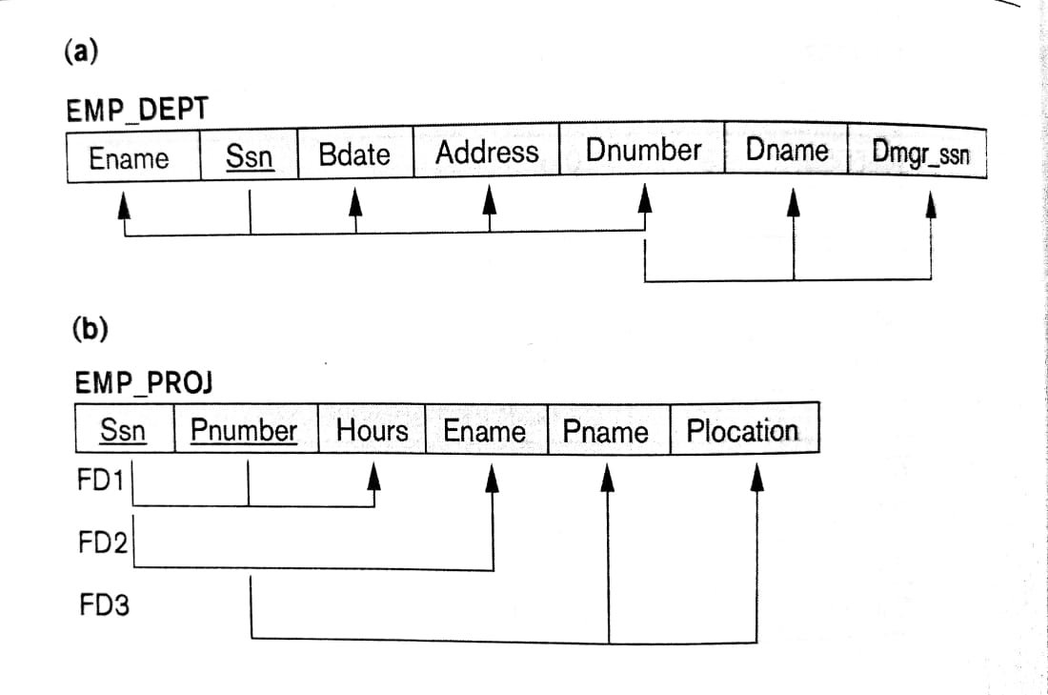
Imparting clear semantics to attributes in relations
The semantics of a relation refers to its meaning resulting from the interpretation of attribute values in a tuple
Guideline-1: Do not combine attributes from multiple entity types and relationship types into a single relation
Ex. Violating guideline 1

Slide 4
Redundant Information in Tuples and Update Anomalies
Insertion Anomalies: Considering Emp_Dept relation
Here to inert new employee tuple into the Emp_Dept relation then, we must either include the values for the department, in which the employee will work for or NULLs if not assigned any department yet
It is also difficult to inert a new department that has no employee. The possible option is to put NULL values in all attributes of employee
Deletion Anomalies
Modification Anomalies:
Ex. Modify the manager of a department will force to update all the employee row also who work for that department
Guideline 2: Design the base relation schema so that no anomalies are present in the relations.

Slide 5
NULL values in Tuples
Guideline 3:
Avoid placing attributes in a base relation whose values may frequently be null.
If NULLs are unavoidable, make sure that they apply in exceptional cases only do not apply to majority of tuples in the relation
Generation of spurious tuples
Guideline 4:
Design relational schemas so that they can be joined with equality conditions on attributes that are appropriately related pairs (PK & FK) in a way that guarantees that no spurious tuples are generated

Slide 6
Codd's Rules
Every database has cannot be referred to as a rational database system.
If any database has only relational data model, it cannot be a Relational Database System (RDBMS).
So, some rules define a database to be the correct RDBMS.
These rules were developed by Dr. Edgar F. Codd (E.F. Codd) in 1985.
Codd presents his 13 rules for a database to test the concept of DBMS against his relational model, and if a database follows the rule, it is called a true relational database (RDBMS).
These 13 rules are popular in RDBMS, known as Codd's 12 rules

Slide 7
Rule 0: The Foundation Rule
The database must be in relational form. So that the system can handle the database through its relational capabilities.
Rule 1: Information Rule
A database contains various information, and this information must be stored in each cell of a table in the form of rows and columns.
Rule 2: Guaranteed Access Rule
Every single or precise data (atomic value) may be accessed logically from a relational database using the combination of primary key value, table name, and column name.
Rule 3: Systematic Treatment of Null Values
This rule defines the systematic treatment of Null values in database records. The null value has various meanings in the database, like missing the data, no value in a cell, inappropriate information, unknown data and the primary key should not be null.

Slide 8
Rule 4: Active/Dynamic Online Catalog based on the relational model
It represents the entire logical structure of the descriptive database that must be stored online and is known as a database dictionary. It authorizes users to access the database and implement a similar query language to access the database.
Rule 5: The comprehensive data sublanguage rule:
A relational system may support several languages and various modes of terminal use (for example, the fill-in-the-blanks mode). However, there must be at least one language whose statements are expressible, per some well-defined syntax, as character strings and that is comprehensive in supporting all of the following items:
Data definition.
View definition.
Data manipulation (interactive and by program).
Integrity constraints.
Authorization.
Transaction boundaries (begin, commit and rollback).

Slide 9
Rule 6: View Updating Rule
All views table can be theoretically updated and must be practically updated by the database systems.
Rule 7: Relational Level Operation (High-Level Insert, Update and delete) Rule
A database system should follow high-level relational operations such as insert, update, and delete in each level or a single row. It also supports union, intersection and minus operation in the database system.
Rule 8: Physical Data Independence Rule
All stored data in a database or an application must be physically independent to access the database. Each data should not depend on other data or an application. If data is updated or the physical structure of the database is changed, it will not show any effect on external applications that are accessing the data from the database.

Slide 10
Rule 9: Logical Data Independence Rule
It is similar to physical data independence. It means, if any changes occurred to the logical level (table structures), it should not affect the user's view (application). For example, suppose a table either split into two tables, or two table joins to create a single table, these changes should not be impacted on the user view application.
Rule 10: Integrity Independence Rule
A database must maintain integrity independence when inserting data into table's cells using the SQL query language. All entered values should not be changed or rely on any external factor or application to maintain integrity. It is also helpful in making the database-independent for each front-end application.

Slide 11
Rule 11: Distribution Independence Rule
The distribution independence rule represents a database that must work properly, even if it is stored in different locations and used by different end-users. Suppose a user accesses the database through an application; in that case, they should not be aware that another user uses particular data, and the data they always get is only located on one site. The end users can access the database, and these access data should be independent for every user to perform the SQL queries.
Rule 12: Non Subversion Rule
The non-submersion rule defines RDBMS as a SQL language to store and manipulate the data in the database. If a system has a low-level or separate language other than SQL to access the database system, it should not subvert or bypass integrity to transform data.

Slide 12
Functional dependency
A functional dependency is a constraint that specifies the relationship between two sets of attributes where one set can accurately determine the value of other sets.
A functional dependency is denoted by an arrow “→”. The functional dependency X → Y, where X is a set of attributes that is capable of determining the value of Y.
The attribute set on the left side of the arrow, X is called Determinant, while on the right side, Y is called the Dependent.
Functional dependencies are used to mathematically express relations among database entities and are very important to understand advanced concepts in Relational Database System

Slide 13
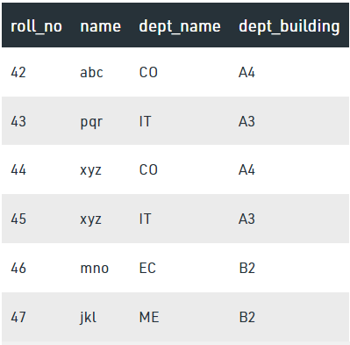
From the table we can conclude some valid functional dependencies: roll_no → { name, dept_name, dept_building }, Here, roll_no can determine values of fields name, dept_name and dept_building, roll_no → dept_name , Since, roll_no can determine whole set of {name, dept_name, dept_building}, it can determine its subset dept_name also. dept_name → dept_building , Dept_name can identify the dept_building accurately, since departments with different dept_name will also have a different dept_building More valid functional dependencies: roll_no → name, {roll_no, name} ⇢ {dept_name, dept_building}, etc.

Slide 14
Armstrong’s axioms/properties of functional dependencies:
Reflexivity: If Y is a subset of X, then X→Y holds by reflexivity rule
For example, {roll_no, name} → name is valid.
Augmentation: If X → Y is a valid dependency, then XZ → YZ is also valid by the augmentation rule.
For example, If {roll_no, name} → dept_building is valid, hence {roll_no, name, dept_name} → {dept_building, dept_name} is also valid.→
Transitivity: If X → Y and Y → Z are both valid dependencies, then X→Z is also valid by the Transitivity rule.
For example, roll_no → dept_name & dept_name → dept_building, then roll_no → dept_building is also valid.

Slide 15
Types of Functional dependencies
Trivial functional dependency
Non-Trivial functional dependency
Multivalued functional dependency
Transitive functional dependency

Slide 16
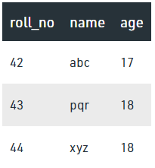
1. Trivial Functional Dependency
In Trivial Functional Dependency, a dependent is always a subset of the determinant.
i.e. If X → Y and Y is the subset of X, then it is called trivial functional dependency
Here, {roll_no, name} → name is a trivial functional dependency, since the dependent name is a subset of determinant set {roll_no, name}
Similarly, roll_no → roll_no is also an example of trivial functional dependency.

Slide 17
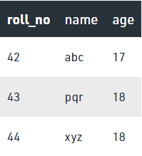
2. Non-trivial Functional Dependency
In Non-trivial functional dependency, the dependent is strictly not a subset of the determinant.
i.e. If X → Y and Y is not a subset of X, then it is called Non-trivial functional dependency.
Here, roll_no → name is a non-trivial functional dependency, since the dependent name is not a subset of determinant roll_no
Similarly, {roll_no, name} → age is also a non-trivial functional dependency, since age is not a subset of {roll_no, name}

Slide 18
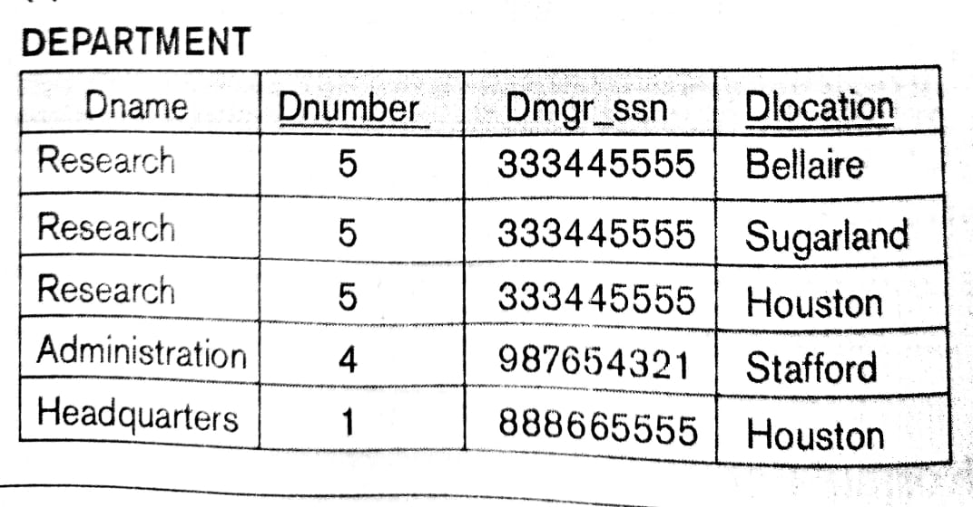
3. Multivalued Functional Dependency
In Multivalued functional dependency, entities of the dependent set are not dependent on each other.
i.e. If a → {b, c} and there exists no functional dependency between b and c, then it is called a multivalued functional dependency.
It is represented by ->> Double Arrow
Ex. In the table DNumber -> Dname, Dnumber -> Dlocation But there is no dependency between Dname and Dlocation, So Dnumber ->> DLocation

Slide 19
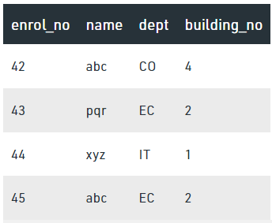
4. Transitive Functional Dependency
In transitive functional dependency, dependent is indirectly dependent on determinant.
i.e. If a → b & b → c, then according to axiom of transitivity, a → c. This is a transitive functional dependency
Here, enrol_no → dept and dept → building_no
Hence, according to the axiom of transitivity, enrol_no → building_no is a valid functional dependency.
This is an indirect functional dependency, hence called Transitive functional dependency.

Slide 20
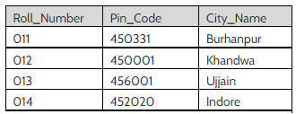
Transitive FD example
From above table,
Roll_Number --> Pin_Code and Pin_Code --> City_Name hold.
Than Roll_Number --> City_Name is a transitive FD.

Slide 21
Normalization
It is the process of decomposing unsatisfactory "bad“ relations by breaking up their attributes into smaller relations
Normalization is carried out in practice so that the resulting designs are of high quality and meet the desirable properties
Normal form:
Condition using keys and FDs of a relation to certify whether a relation schema is in a particular normal form

Slide 22
Definitions of Keys and Attributes Participating in Keys
Database_Keys.pptx
A super key of a relation schema R = {A1, A2, ...., An} is a set of attributes S subset-of R with the property that no two tuples t1 and t2 in any legal relation state r of R will have t1[S] = t2[S]
A Candidate key K is a super key with the additional property that removal of any attribute from K will cause K not to be a super key any more.
OR
Minimal Super Key with unique and not null values can be a candidate key
One of the candidate keys is arbitrarily designated to be the primary key, and the others are called secondary Keys / Alternate Keys
A Prime attribute must be a member of some candidate key
A Nonprime attribute is not a prime attribute— that is, it is not a member of any candidate key

Slide 23
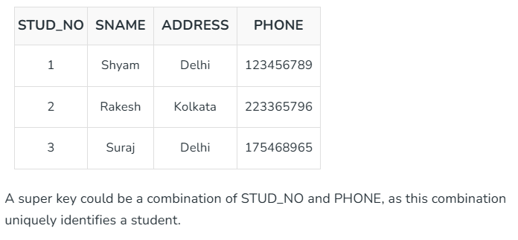
Super Key
Definition: Set of one or more attributes that can uniquely identify a tuple.
Can include extra attributes not necessary for uniqueness.
Example: STUD_NO, (STUD_NO, STUD_NAME)
Super key example: (STUD_NO, PHONE)

Slide 24
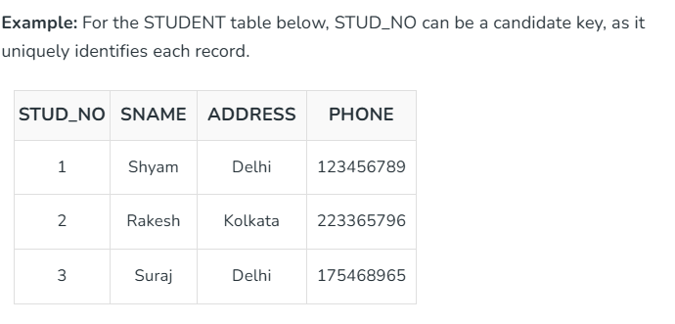
Candidate Key
Definition: Minimal set of attributes that can uniquely identify a tuple.
A minimal super key with no extra attributes.
Example: STUD_NO in STUDENT table
Composite key: {STUD_NO, COURSE_NO} in STUDENT_COURSE

Slide 25
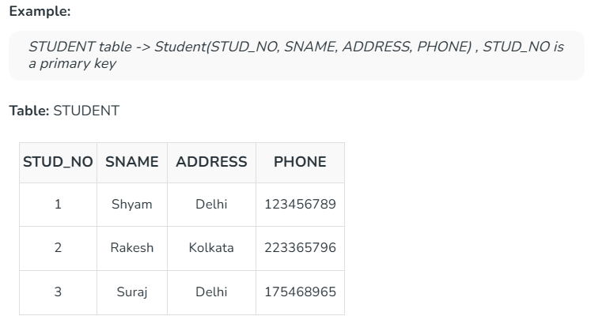
Primary Key
Chosen candidate key to uniquely identify records.
Must be unique and not NULL.
Can be single-column or composite.
Example: STUD_NO in STUDENT table

Slide 26
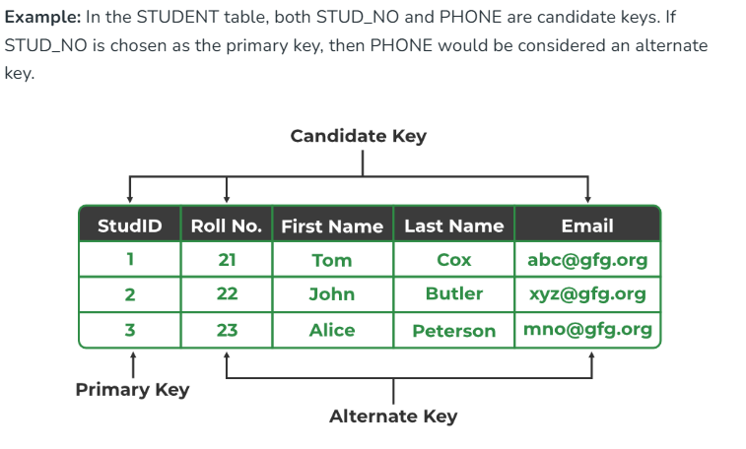
Alternate Key
Candidate key not chosen as the primary key.
Also called secondary key.
Example: If STUD_NO is primary, PHONE is alternate key

Slide 27
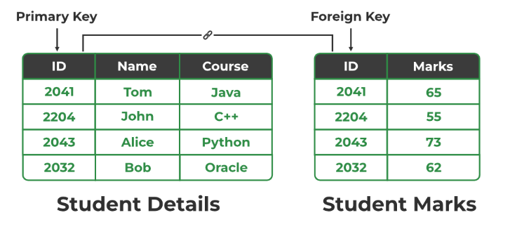
Foreign Key
Attribute in one table that references primary key of another table.
Ensures data integrity and relationship between tables.
Example: STUD_NO in STUDENT_COURSE references STUDENT.STUD_NO

Slide 28
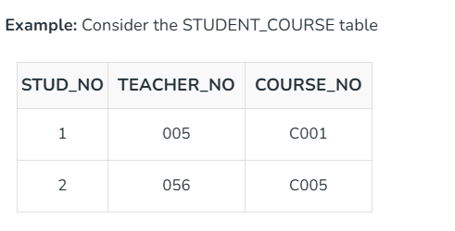
Composite Key
Combination of two or more attributes to uniquely identify a row.
Can act as primary key if no other key exists.
Example: {STUD_NO, COURSE_NO} in STUDENT_COURSE table

Slide 29
Summary Table of Keys
Super Key: (STUD_NO, PHONE)
Candidate Key: STUD_NO
Primary Key: STUD_NO
Alternate Key: PHONE
Foreign Key: STUD_NO in STUDENT_COURSE
Composite Key: {STUD_NO, COURSE_NO}
STUD_NO (PK) | NAME | PHONE (Alternate Key) | CITY
S101 | Riya Sharma | 9876543210 | Delhi
S102 | Aarav Mehta | 9123456789 | Mumbai
S103 | Neha Patel | 9988776655 | Pune
COURSE_NO (PK) | COURSE_NAME
C01 | DBMS
C02 | Java
C03 | Python
STUD_NO (FK) | COURSE_NO (FK)
S101 | C01
S101 | C02
S102 | C01
S103 | C03

Slide 30
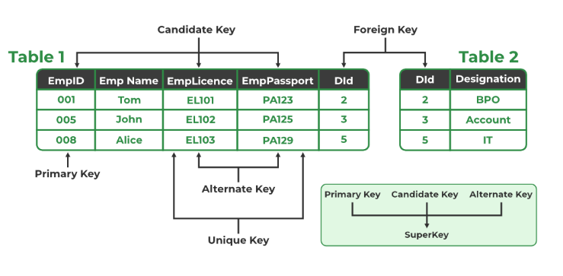

Slide 31
Normalization
First Normal Form(1NF):
This rule defines that all the attributes in a relation must have atomic domains. The values in an atomic domain are indivisible units.
Eg.
Convert into 1st NF as:
{Car_Model, Color, Price} with multiple records for Car Model
Here in 1st NF we don’t create any Primary key.
Car_model | Color | Price
1 | Red, Grey, Black | 5lk , 6lk , 4.5lk
2 | Red, Yellow, White | 5.5 lk , 4lk, 6lk
3 | Black, White | 7lk , 6lk
4 | White, Grey | 6lk , 7lk

Slide 32
Second Normal Form(2NF):
Every non-prime attribute should be fully functionally dependent on prime key attribute.
That is, if X → A holds, then there should not be any proper subset Y of X, for which Y → A also holds true.
Eg.
R => Stud_Proj = {stud_id, name, proj_id, proj_name}
Student: {stud_Id, name, proj_Id,}
Project: {proj_id, proj_name}
stud_id | name | proj_id | proj_name
S101 | Riya Sharma | P01 | Library System
S102 | Aarav Mehta | P02 | Online Shopping
S103 | Neha Patel | P03 | Weather App
S104 | Karan Verma | P01 | Library System
S105 | Priya Desai | P02 | Online Shopping

Slide 33
Third Normal Form(3NF):
For a relation to be in Third Normal Form, it must be in Second Normal form and the following must satisfy
No non-prime attribute is transitively dependent on prime key attribute.
For any non-trivial functional dependency,
X → A, then either
X is a superkey or
A is prime attribute.
Ex.
Stud_Proj = {stud_id, name, proj_id, proj_name}
Student: {stud_Id, name, proj_Id,}
Project: {proj_id, proj_name}
stud_Id → proje_Id , proje_Id → proj_name

Slide 34
Example of Normalization
StudentID | StudentName | CourseID | CourseName | CourseFee | InstructorName | InstructorPhone
1 | Amit | C101 | DBMS | 5000 | Prof. Mehta | 9876543210
2 | Rina | C102 | Python | 6000 | Prof. Shah | 9876543222
3 | Kiran | C101 | DBMS | 5000 | Prof. Mehta | 9876543210
Step 1: Check 1NF
All attributes contain atomic values. Already in 1NF.

Slide 35
Step 2: Check 2NF
Primary Key could be (StudentID, CourseID).
CourseName, CourseFee, InstructorName, InstructorPhone depend only on CourseID, not on StudentID → partial dependency.
So, split into two tables:
StudentID | StudentName | CourseID
1 | Amit | C101
2 | Rina | C102
3 | Kiran | C101
CourseID | CourseName | CourseFee | InstructorName | InstructorPhone
C101 | DBMS | 5000 | Prof. Mehta | 9876543210
C102 | Python | 6000 | Prof. Shah | 9876543222

Slide 36
Step 3: Check 3NF
In COURSE table, InstructorPhone depends on InstructorName, not directly on CourseID.
This is a transitive dependency.
Decompose to 3NF
We create a separate INSTRUCTOR Table.
StudentID | StudentName | CourseID
1 | Amit | C101
2 | Rina | C102
3 | Kiran | C101
CourseID | CourseName | CourseFee | InstructorName
C101 | DBMS | 5000 | Prof. Mehta
C102 | Python | 6000 | Prof. Shah
InstructorName | InstructorPhone
Prof. Mehta | 9876543210
Prof. Shah | 9876543222

Slide 37
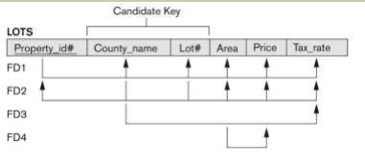
Example for Normalization
The above relation describes parcels of land for sale in various county of a state. Suppose there are 2 candidate keys as:
1. Property_ID
2. County_Name and Lot_No

Slide 38
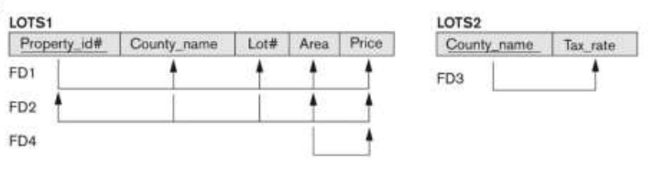
2 NF Conversion
Remove partial functional dependency
County_Name -> Tax_Rate

Slide 39
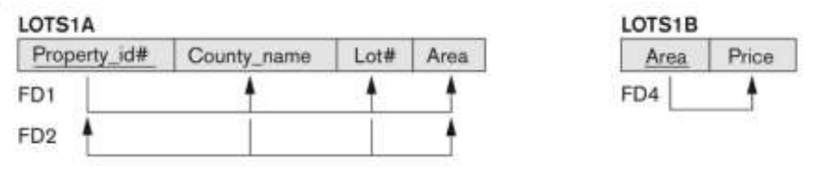
3 NF Conversion of relation LOT1
Here remove transitive dependency
Area -> Price and
Property_Id -> Area

Slide 40
BCNF – Boyce Codd Normal Form
BCNF is the advance version of 3NF. It is stricter than 3NF.
A table is in BCNF if every functional dependency X → Y,
X is the super key of the table.
For BCNF, the table should be in 3NF, and for every FD, LHS is super key.
General definition of 3NF is:
For any FD X->Y:
X is a super Key of R OR
Y is a Prime Attribute of R

Slide 41
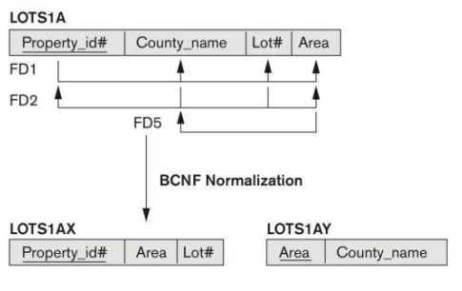
BCNF
In the above relation LOTs1A if we assume that the Lot size/ area is fix per county and they are from 2 county only
So in that case we can add one more FD i.e. Area -> County_Name
So, according to 3NF this is allowed FD as: Area is not a super key according to rule (i) but as rule (ii) says County_Name is a prime attribute.
But according to BCNF only one condition is allowed for FD is that the determinant must be a super key. So, Need to convert the relation LOTs1A into BCNF as shown below:

Slide 42


BCNF Example
Candidate Key:
{Student, Course}
FDs:
{Student, Course} -> Instructor
Instructor -> Course
Decomposition Rule:

Slide 43
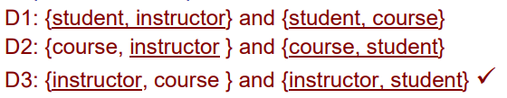
Conversion into BCNF
Out of all above 3 decomposition
Only D3 follows the decomposition rule for BCNF
So D3 is the only valid decomposition

Slide 44
R(StudentID, StudentName, CourseID, CourseName, InstructorID, InstructorName, Dept, Grade)
Examples for Normalization
Given functional dependencies (FDs)
FD1 : StudentID → StudentName
FD2 : CourseID → CourseName, InstructorID
FD3 : InstructorID → InstructorName, Dept
FD4 : {StudentID, CourseID} → Grade

Slide 45
Explanation
Key: {StudentID, CourseID}
After 2NF:
R1: Student (StudentID , StudentName)
R2: Course (CourseID, CourseName, InstructorID, InstructorName, Dept)
R3: Enrollment (StudentID, CourseID, Grade)
After 3NF:
R1 and R3 will remain as it is and remove transiti FD from R2
R2a : Instructor(InstructorID PK, InstructorName, Dept)
R2b : Course(CourseID PK, CourseName, InstructorID)

Slide 46
Examples for Normalization
R(StuID, StuName, Dept, CourseID, CourseName, Instructor, RoomNo)
StuID → StuName, Dept(Student ID uniquely identifies student info)
CourseID → CourseName, Instructor(Each course has a fixed name and instructor)
Instructor → RoomNo(An instructor is assigned a specific room for lectures)
(StuID, CourseID) → (all other attributes)
(Student enrollment in a course is uniquely identified by StuID+CourseID)

Slide 47
Decomposition
R = (StuID, StuName, Dept, CourseID, CourseName, Instructor, RoomNo) already in 1NF
Primary key = (StuID, CourseID) (composite).
In 2NF, no non-prime attribute should depend on part of composite key.
Check partial dependencies:
StuID → StuName, Dept → partial dependency (depends only on StuID).
CourseID → CourseName, Instructor → partial dependency (depends only on CourseID).
So 2NF decompose:
R1(StuID, StuName, Dept)
R2(CourseID, CourseName, Instructor, RoomNo)
R3(StuID, CourseID)

Slide 48
3NF
Check transitive dependencies:
In R2: CourseID → Instructor and Instructor → RoomNo → CourseID → RoomNo (transitive dependency).
Decompose R2:
R2a(CourseID, CourseName, Instructor)
R2b(Instructor, RoomNo)
Now all transitive dependencies are removed.
So after 3NF decomposition:
R1(StuID, StuName, Dept)
R2a(CourseID, CourseName, Instructor)
R2b(Instructor, RoomNo)
R3(StuID, CourseID)

Slide 49
Normalisation Example - 1
Dept_Name | D_No | D_Mgr_SSN | Dept_Location
Research | 5 | 501 | Banglore, Kolkota
Administration | 4 | 401 | Delhi, Mumbai
Sales | 1 | 101 | Ahmedabad, Banglore, Delhi

Slide 50
Example - 2
SSN | Proj_No | Emp_Hours | Emp_Name | Proj_Name | Proj_Loc
101 | P1 | 20 | Ankit Shah | Renovation | Bopal
101 | P2 | 50 | Ankit Shah | Construction | Ghuma
102 | P2 | 70 | Ankit Shah | Construction | Bopal
103 | P2 | 40 | Bhumi Patel | Construction | Sarkhej
103 | P3 | 30 | Bhumi Patel | Designing | Maninagar

Slide 51
Example - 3
Property_ID | City | Plot_No | Area | Price
Functional Dependencies are given as below:
FD1: Property_ID → {City, Plot_No, Area, Price}
FD2: {City, Plot_No} → {Property_ID, Area, Price}
FD3: Area → Price
FD4: Area → City (Consider this special condition, FD just for BCNF)

Slide 52
Multivalued Dependency
Multivalued dependency occurs when two attributes in a table are independent of each other but, both depend on a third attribute.
A multivalued dependency consists of at least two attributes that are dependent on a third attribute that's why it always requires at least three attributes.

Slide 53
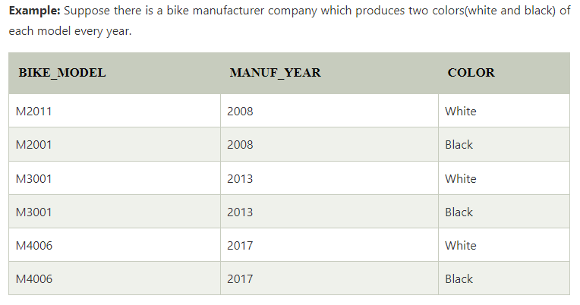
Here columns COLOR and MANUF_YEAR are dependent on BIKE_MODEL and independent of each other.
In this case, these two columns can be called as multivalued dependent on BIKE_MODEL. The representation of these dependencies is shown below:
BIKE_MODEL → → MANUF_YEAR
BIKE_MODEL → → COLOR

Slide 54

4NF
Any relation is said to be in the fourth normal form when it satisfies the following conditions:
It must be in Boyce Codd Normal Form (BCNF).
It should have no multi-valued dependency.

Slide 55
Join Dependency
Join decomposition is a further generalization of Multivalued dependencies. If the join of R1 and R2 over C is equal to relation R then we can say that a join dependency (JD) exists, where R1 and R2 are the decomposition R1(A, B, C) and R2(C, D) of a given relations R (A, B, C, D).
Alternatively, R1 and R2 are a lossless decomposition of R. A JD ⋈ {R1, R2, …, Rn} is said to hold over a relation R if R1, R2, ….., Rn is a lossless-join decomposition.
The *(A, B, C, D), (C, D) will be a JD of R if the join of join’s attribute is equal to the relation R.
Here, *(R1, R2, R3) is used to indicate that relation R1, R2, R3 and so on are a JD of R.

Slide 56
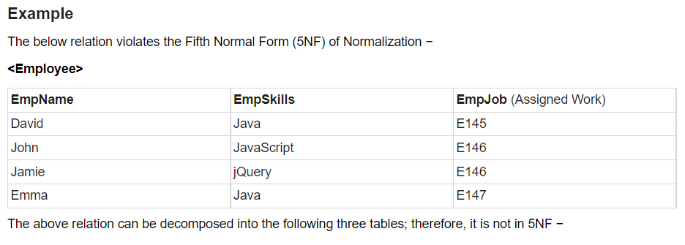
5NF
A relation is in Fifth Normal Form (5NF), if it is in 4NF, and won’t have join dependency.
You can also consider that a relation is in 5NF, if the candidate key implies every join dependency in it.

Slide 57
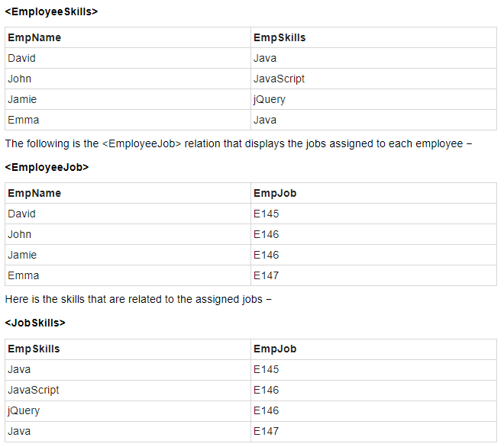

Slide 58
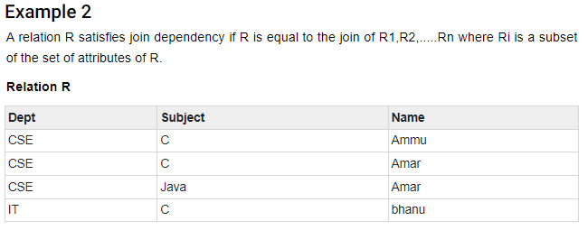
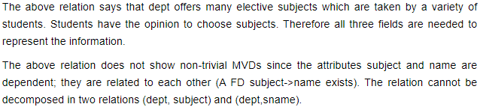

Slide 59
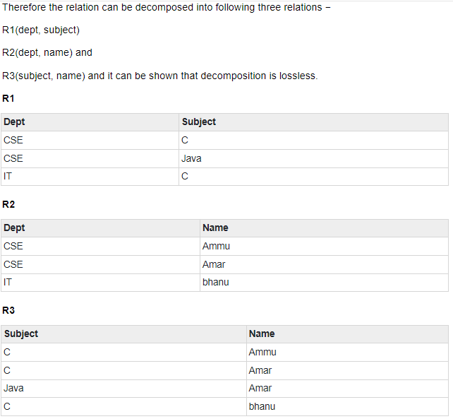

Slide 60
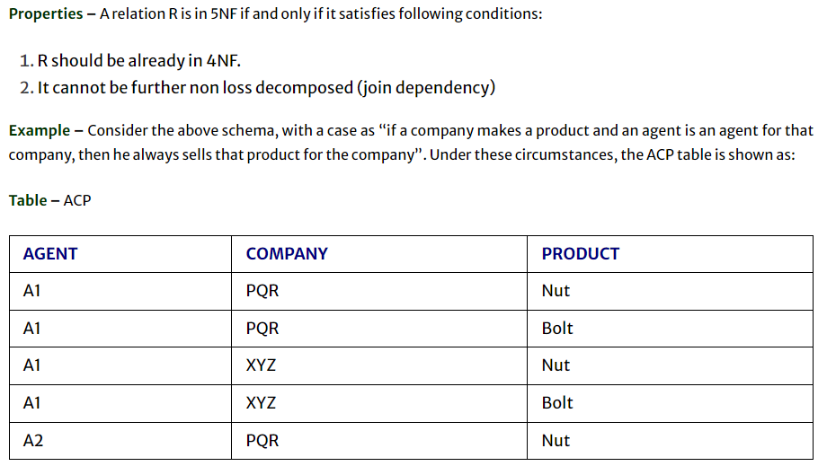
EXAMPLE - 3

Slide 61
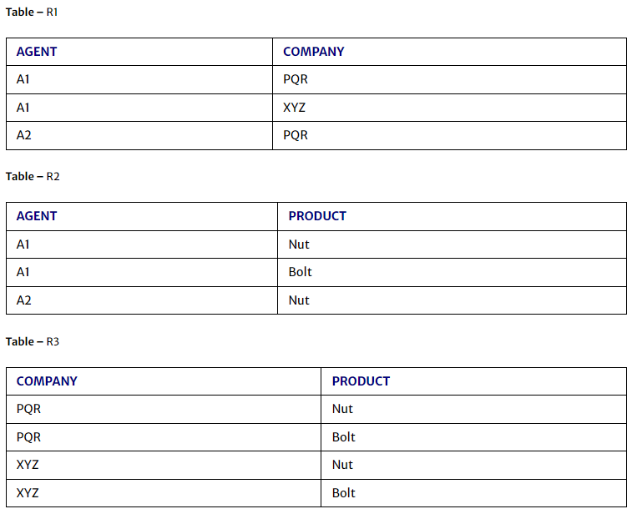
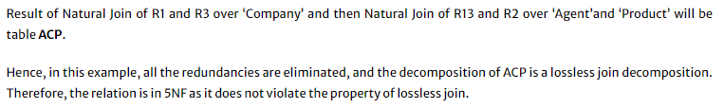

Slide 62
